Slide 1
Enhanced Personal Delivery
November 2023 Release

Slide 2
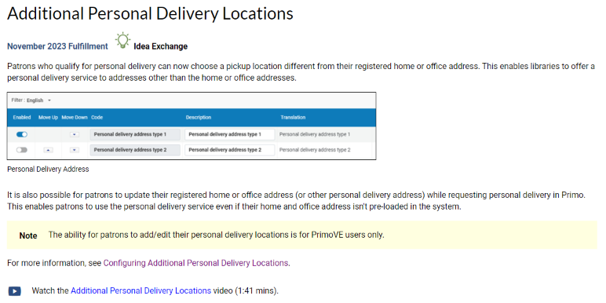
Enhanced Personal Delivery - Alma

Slide 3
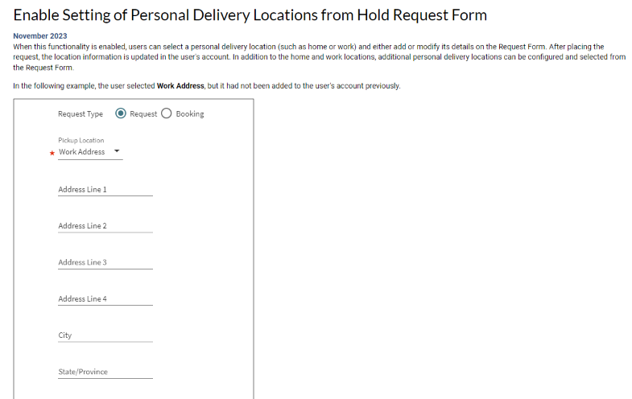
Enhanced Personal Delivery - Primo

Slide 4

Agenda
Use case 1 : Request form allows requesting for Work Address
Use case 2 : Add 'Pick Up Address' that is managed by library
Use case 3 : Make Pick Up Address be manageable by patron
Use case 4 : Copy 'Work Address' to be patron's default pick up address (option 1)
Use case 5 : Copy 'Work Address' to be patron's default pick up address (option 2)
Use case 6 : Delivery

Slide 5
Use case 1: Request form allows requesting for Work Address

Slide 6
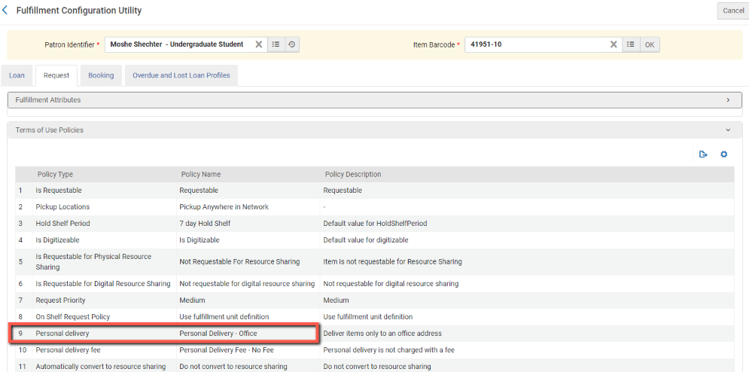
STEP 1 : ALLOW PERSONAL DELIBERY

Slide 7
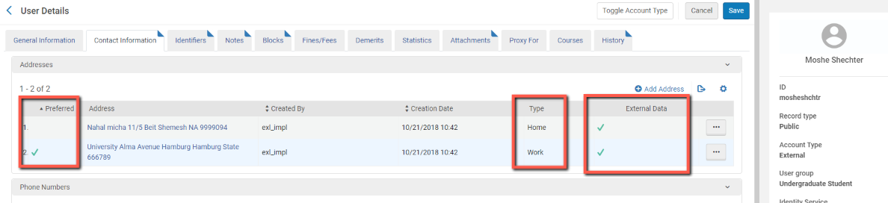
STEP 2 : USER HAS PERSONAL DELIVERY ADDRESSES

Slide 8
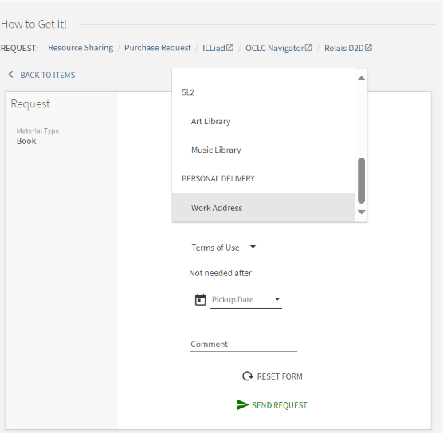
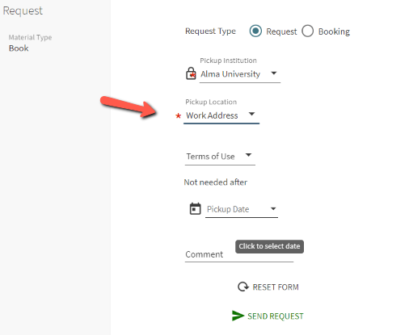
RESULT : PRIMO REQUEST FORM ALLOWS PERSONAL DELIVERY

Slide 9
Use case 2 : Add 'Pick Up Address' that is managed by library

Slide 10
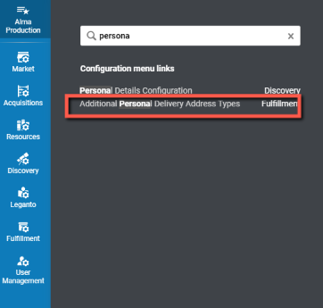
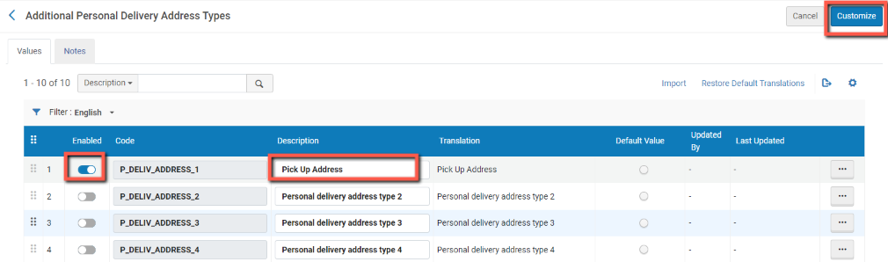
STEP 1 : ENABLE ADDITIONAL DELIVERY LOCATION

Slide 11
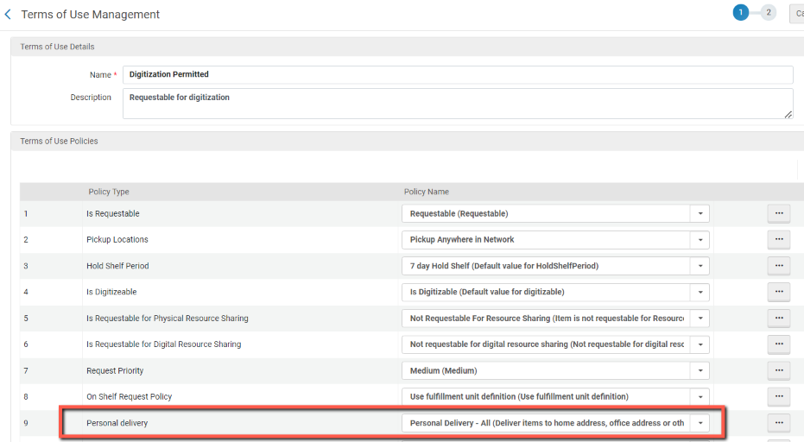
STEP 2 : ENABLE ADDITONAL DELIVERY LOCATIONS IN TOU

Slide 12
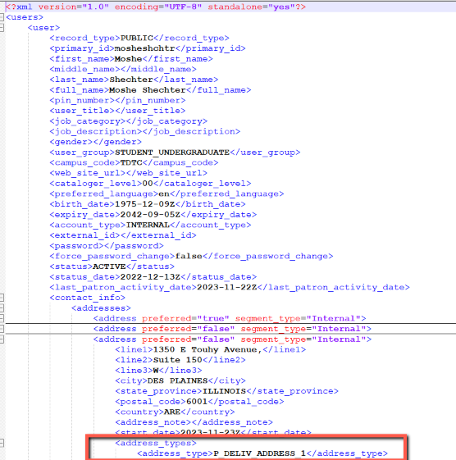
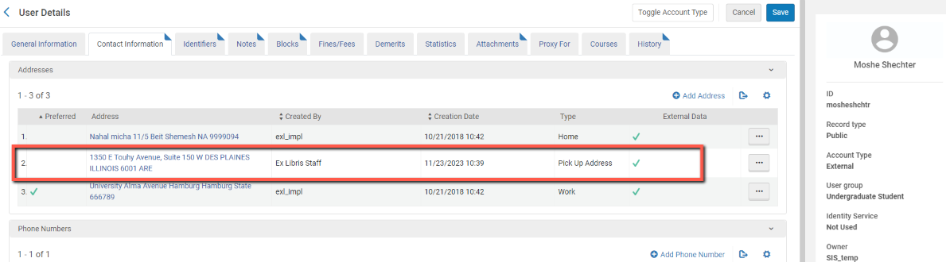

STEP 3 : IMPORT ADDED ADDRESS (SIS)

Slide 13
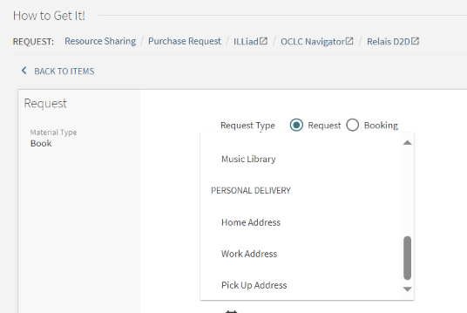
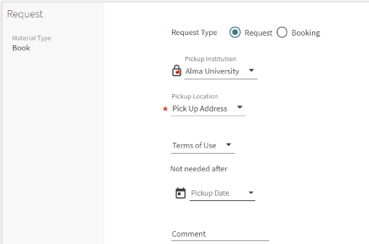
RESULT : ADDITIONAL ADDRESS IS REQUESTABLE

Slide 14
Use case 3 : Make Pick Up Address be manageable by patron

Slide 15
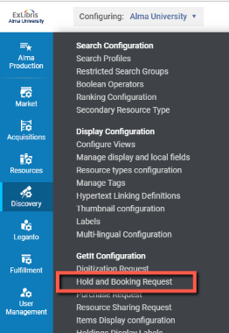
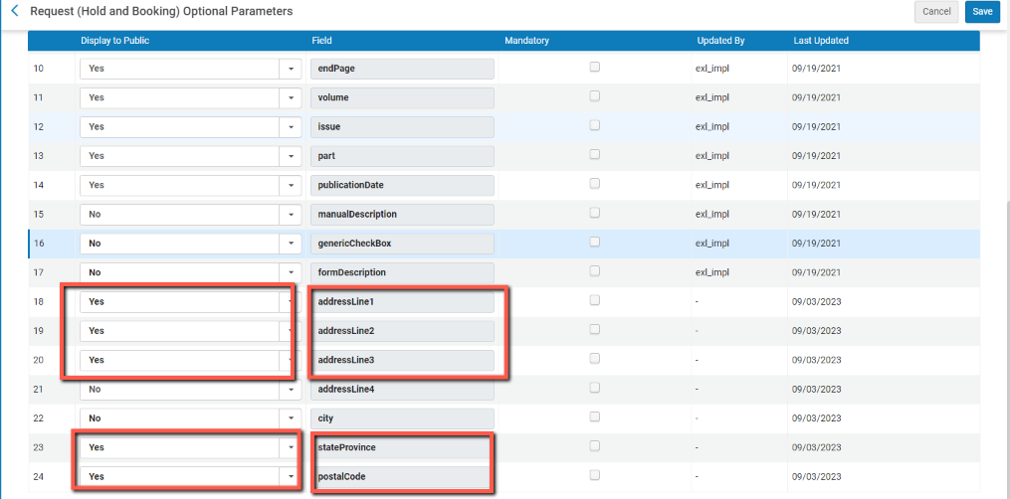
STEP 1 :ENABLE EDITING ADDITIONAL ADDRESS IN PRIMO FORM

Slide 16
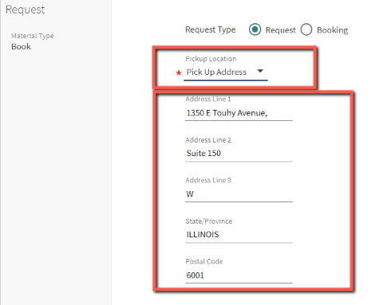
RESULT : PRIMO FORM PRE-POPULATES WITH ADDRESS FIELDS

Slide 17
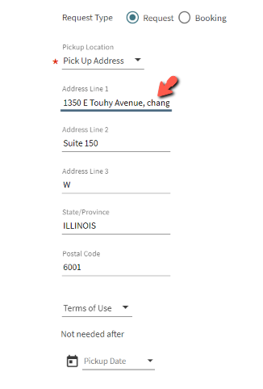
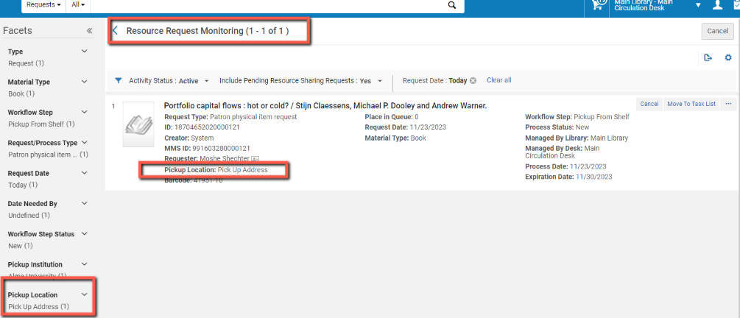
STEP 2 : CHANGE THE ADDRESS + SUBMIT

Slide 18
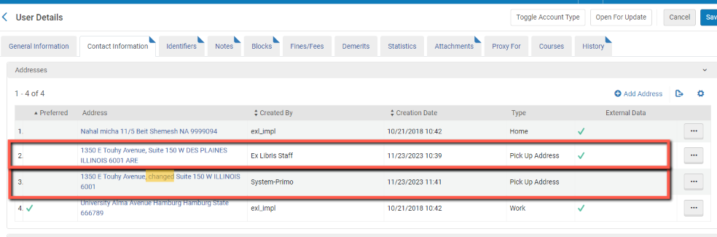
RESULT : ADDITIONAL ADDRESS

Slide 19
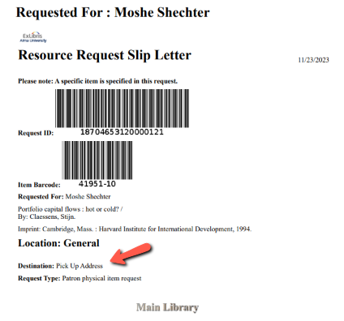
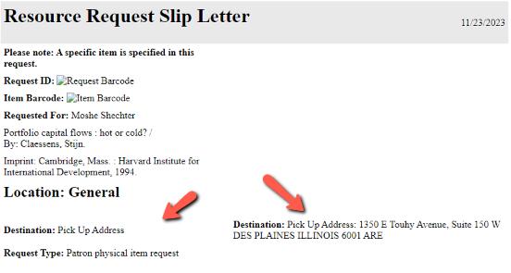
RESULT : ADDRESS CAN BE CONFIGURED ON PICK FORM
Bug ☹

Slide 20
RESULT : ADDRESS MAY BE RE-USED
Next time the patron selects the ‘Pick Up Address’ option, the changed address will automatically populate the form

Slide 21
Use case 4 : Copy 'Work Address' to be patron's default ‘Pick Up Address’ (option 1)

Slide 22
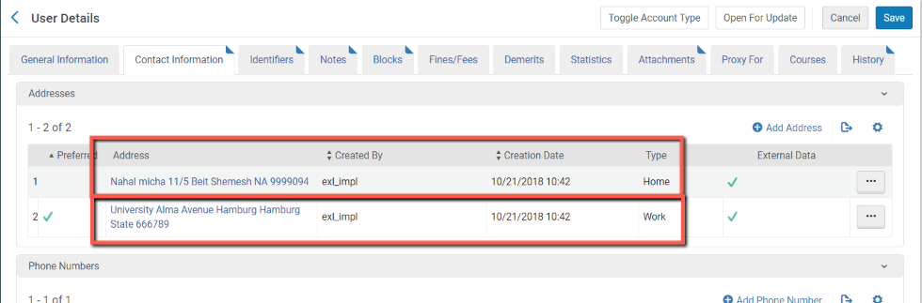
STEP 1 : USER HAS WORK ADDRESS

Slide 23
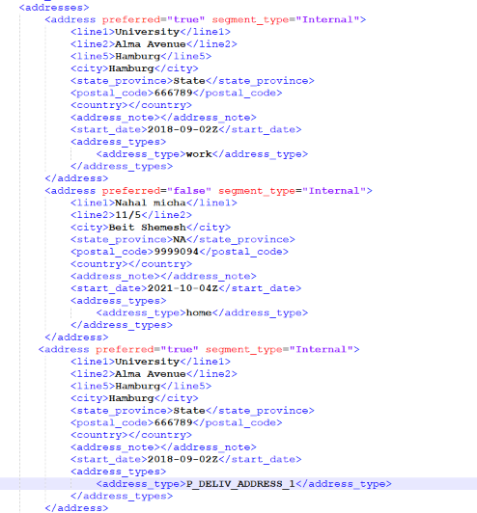
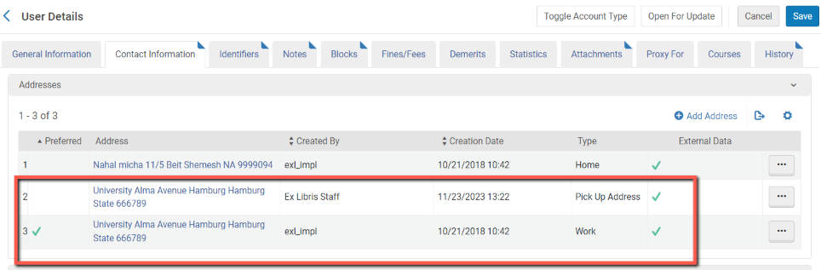
STEP 2 : SIS IS USED TO DUPLICATE WORK ADDRESS AS ‘PICK UP ADDRESS’
In the SIS load, the work address is duplicated as a pickup delivery address
The same address can also be assigned multiple types

Slide 24
Use case 5 : Copy 'Work Address' to be patron's default ‘Pick Up Address’ (option 2)

Slide 25
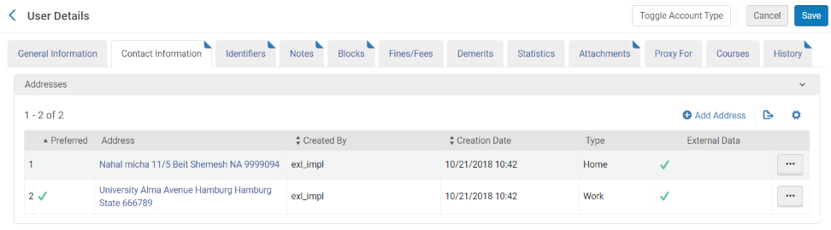
STEP 1 : USER HAS WORK ADDRESS

Slide 26
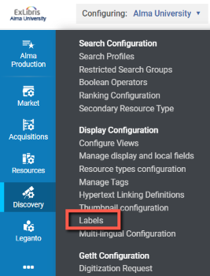

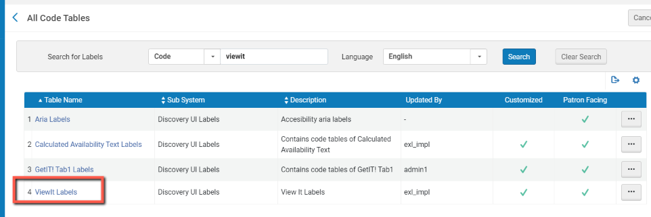
STEP 2.a : PRIMO LABEL IS CHANGED TO EXPOSE THE WORK ADDRESS AS A PICKUP ADDRESS

Slide 27
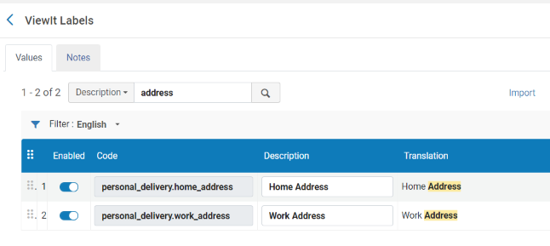
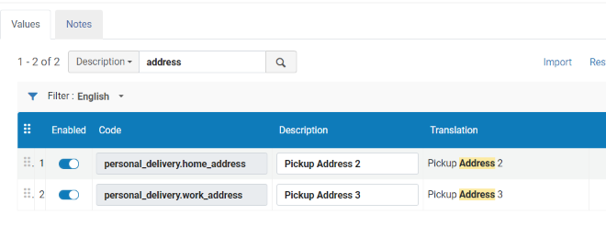
STEP 2.b : PRIMO LABEL IS CHANGED TO EXPOSE THE WORK ADDRESS AS A PICKUP ADDRESS

Slide 28
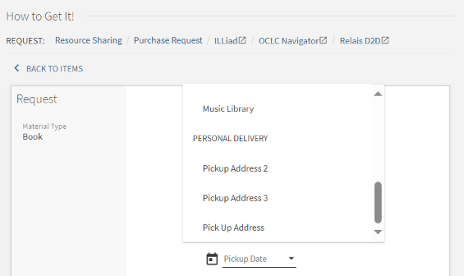
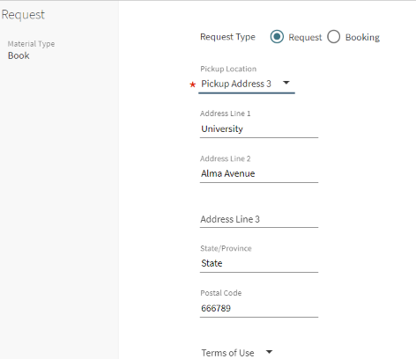
RESULT : PRIMO OFFERS PICKUP ADDRESSES
Pickup Address 3 is pre-popualted with my work address …

Slide 29
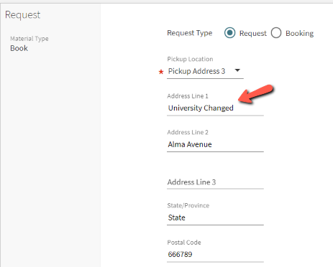
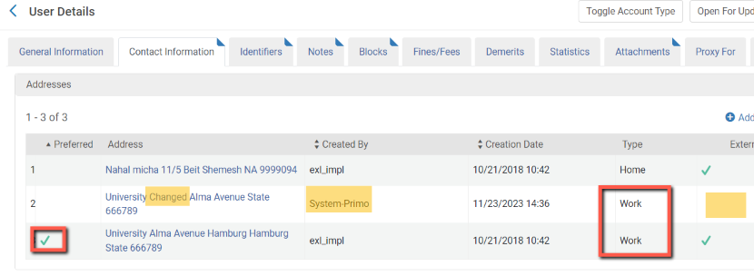
RESULT : CHANGING THE ADDRESS CREATES ANOTHER WORK ADDRESS

Slide 30
Use Case 6 : Delivery

Slide 31
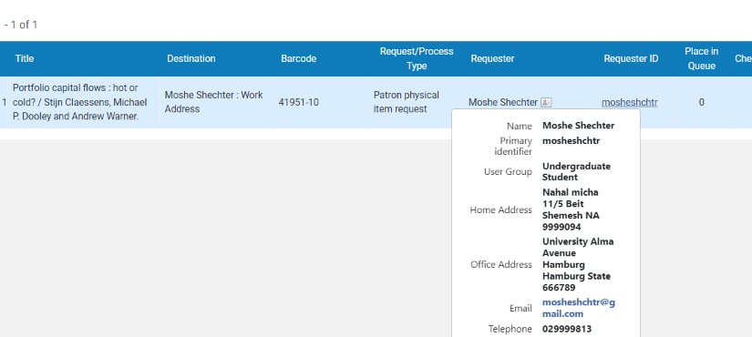
RESULT – WORK ADDRESS SHOWING IN DELIVERY
Bug ☹

